Slide 1
APUSH Review: “New” Immigration
Everything You Need To Know About New Immigration To Succeed In APUSH

Slide 2
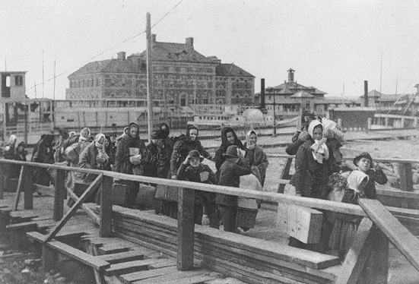
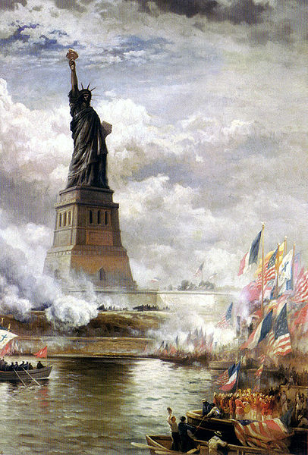
What is “New Immigration?”
What is it?
Immigrants that came from Southern and Eastern Europe
Specific countries?
Poland, Italy, Greece, Hungary, etc.
When did it occur?
1880s – 1920

Slide 3
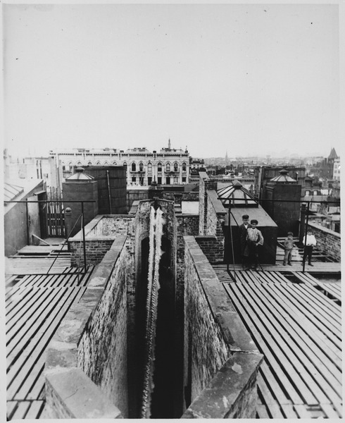
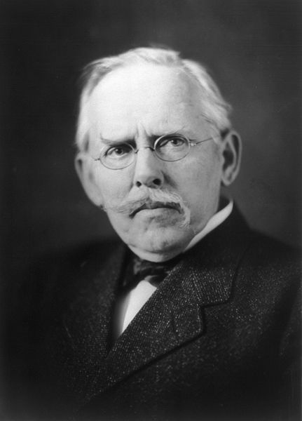
Why did they come here? Where did they settle?
Why they came here?
Economic opportunities
Some came for a short time – “Birds of Passage”
Lack of military conscription
Religious persecution - Jews
Where did they settle?
Overwhelmingly in urban areas
Large cities – NYC and Chicago
Dumbbell tenements
***How the Other Half Lives***

Slide 4
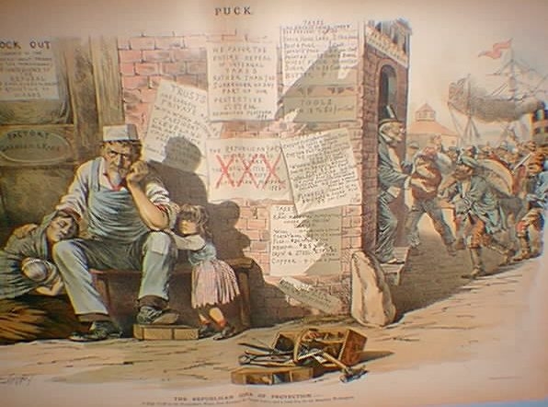

Challenges Faced by “New” Immigrants
Many had a hard time ***Assimilating*** or adjusting to American life
Spoke different languages
Many were highly illiterate
Lived in “ghettos”
New immigrants often worked in unskilled jobs
Often worked for lower wages
Hard to unionize – language barriers
Political bosses often gave immigrants jobs and resources
Immigrants became a strong voting presence

Slide 5
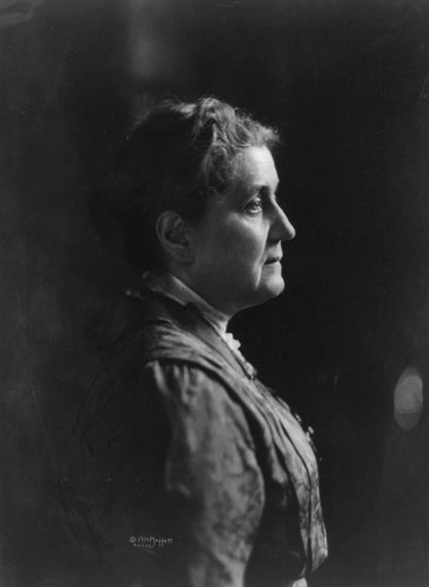

Reactions to “New” Immigrants
Jane Addams – Chicago
Founder of the Hull House
Provided housing, food, and education for poor women and immigrants
Helped spur other settlement houses
Nativism
Fear, distrust, and hatred of foreigners
Causes of Nativism
“taking jobs”
Fear of the Pope
Different government ideas – socialism and anarchism
American Protective Association (APA)
Urged voting against Catholics, favored tougher immigration laws

Slide 6
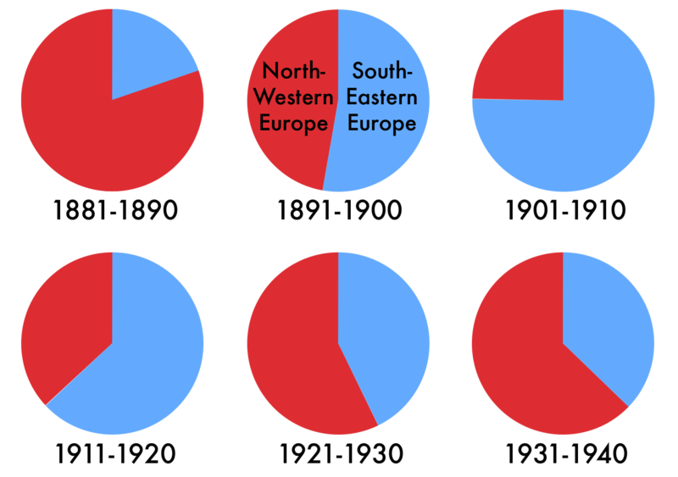
Immigration Laws of the 1920s
Emergency Quota Act of 1921
Restricted number of immigrants from a country to 3% of total people from that country living in US in 1910
Favored Southern and Eastern Europe
National Origins Act of 1924
Quotas for foreigners was cut from 3% to 2%, used 1890 census instead, hurt “New Immigrants”
These two acts signified an end to previously unrestricted immigration

Slide 7
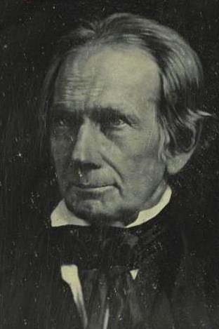
Thanks for watching!
Subscribe to my channel
Help spread the word
Questions? Comments? Ideas for videos?
Leave in comments
I have nothing to do with this topic, but I wanted to make an appearance. Thanks for watching!
Subscribe
Down here!

